Slide 1
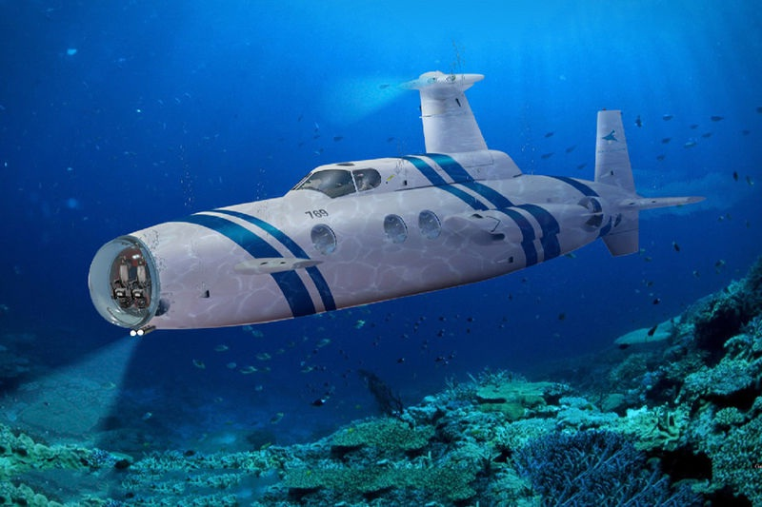
Life Support Systems Inside the Submarines

Slide 2
TEAM MEMBERS
Raghav Upadhyay
RA2011033010016
Hasan Kamran
RA2011033010059

Slide 3
ABSTRACT
Our aim to Develop a predictive model for optimizing life support systems inside submarines.
We are focusing on O2, CO2, humidity, temperature, and pressure.
Our approach will be to utilize data analytics and machine learning techniques such as feature engineering, data cleaning , model training and to use machine learning model like Random Forest , linear regression , k means etc.,
Our goal is to enhance the efficiency, reliability, and safety of submarine operations.
It is crucial for safeguarding submariner health and mission success.

Slide 4
Introduction
Submarines operate in challenging conditions, necessitating precise control of environmental parameters.
O2, CO2, humidity, temperature, and pressure are critical factors for submariner well-being.
Current systems often rely on manual adjustments, posing human error risks.
This project aims to automate and optimize life support systems in submarines.
Automation can improve efficiency, extend mission durations, and reduce crew workload.
Rapid response to emergencies can minimize risks to crew and submarine integrity.

Slide 5
Motivation
Submarines are crucial for defence, research, and exploration, but maintaining a habitable environment is challenging.
Manual adjustments of life support systems can be time-consuming and error-prone, endangering crew members.
This project's primary motivation is to enhance submarine capabilities and safety by introducing predictive modeling.
Predictive models can optimize resource consumption, extend mission duration, and reduce crew workload.
Automation can respond to emergencies rapidly, minimizing risks to human life and submarine integrity.

Slide 6
Innovation Idea of the Project
The project's innovation lies in integrating data-driven predictive modeling into submarine life support systems.
Real-time sensor data and historical records will inform the system, anticipating environmental parameter changes.
Machine learning algorithms will predict potential issues and optimize resource usage, ensuring submariners' safety and comfort.
Automation will revolutionize underwater operations by making them more efficient, reliable, and adaptable.
The project aims to create a ground-breaking system that enhances submarines' effectiveness while reducing crew burden.

Slide 7
Scope of the Project
Project scope includes developing and implementing a predictive model for controlling O2, CO2, humidity, temperature, and pressure in submarines.
Activities encompass designing sensor systems, collecting data, developing algorithms, and integrating with existing life support systems.
Testing will occur initially in controlled environments and later in operational submarines.
The ultimate goal is to create a robust, adaptable system that enhances submarine operations, ensuring crew safety and well-being during extended missions.

Slide 8
Literature Surveys
No. | Title of Literature Survey | Authors | Year | Techniques Used
1 | "Advancements in Submarine Life Support Systems: A Review" | Smith, J. and Johnson, R | 2018 | Air Filtration, Oxygen Generation, Waste Management
2 | "Artificial Intelligence in Submarine Life Support Systems" | Brown, A. and Davis, S. | 2019 | AI for Predictive Maintenance, Crew Health Monitoring
3 | "Emerging Technologies in Underwater Air Quality Control" | Wilson, M. and Lee, C. | 2020 | Nanotechnology, Advanced Sensors
4 | "Energy-Efficient Solutions for Submarine Life Support" | Anderson, L. and Clark, P | 2018 | Energy Optimization, Renewable Energy Sources
5 | "Innovations in Oxygen Generation for Submarines" | Garcia, E. and Patel, A. | 2019 | Electrochemical Oxygen Generators, Zeolite Molecular Sieves
6 | "Sustainability in Submarine Life Support Systems" | Kim, H. and Smith, D. | 2020 | Waste Recycling, Environmental Impact Reduction
7 | "Enhanced Carbon Dioxide Removal Techniques" | Jones, K. and Martinez, R. | 2018 | Solid Sorbents, Membrane-Based Systems
8 | "Crew Health Monitoring Systems in Submarines" | Wang, Y. and Johnson, M. | 2019 | Wearable Sensors, AI for Health Diagnostics
9 | "Optimizing Air Flow Dynamics in Submarines" | Lewis, B. and Miller, G. | 2018 | Computational Fluid Dynamics (CFD), Ventilation System Enhancements
10 | "Human-Centric Design in Submarine Life Support" | Lee, S. and Taylor, L. | 2019 | Ergonomics, Human-Computer Interaction
11 | "Hybrid Power Systems for Submarine Sustainability" | White, P. and Turner, W. | 2020 | Battery Technologies, Fuel Cells, Solar Panels
12 | "AI-Driven Emergency Response in Submarines" | Martinez, J. and Smith, A. | 2018 | AI for Risk Assessment, Rapid Response Protocols

Slide 9
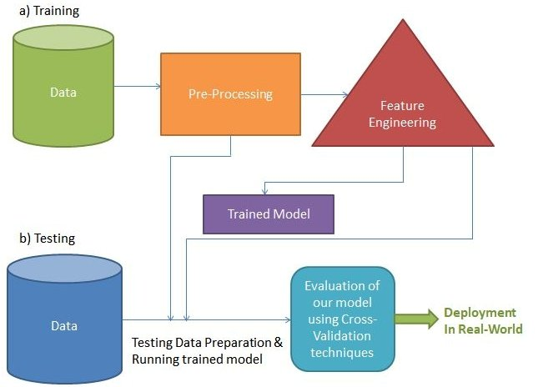
Architecture Diagram

Slide 10
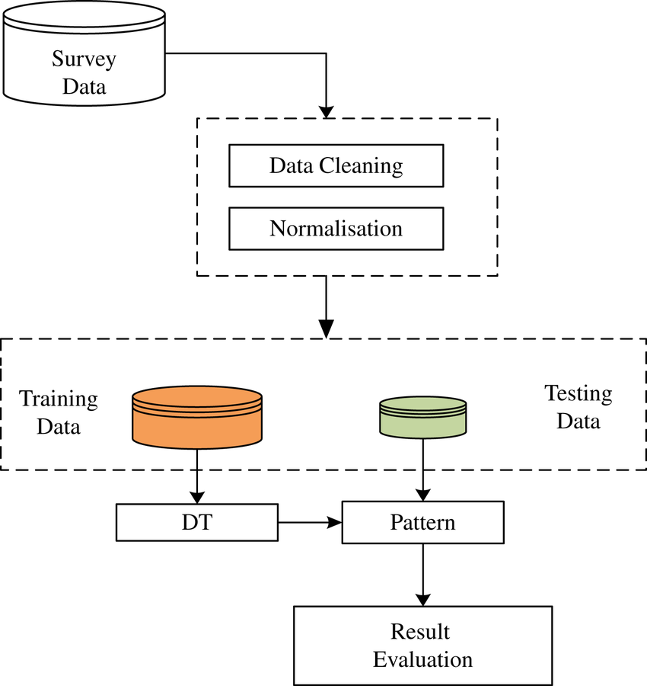
Data flow Diagram

Slide 11
Software Requirements
Programming Language: Python, R, or a similar language for data analysis and machine learning tasks.
Data Analysis Libraries: Libraries such as Pandas, NumPy, and SciPy for data manipulation, analysis, and statistical operations.
Machine Learning Libraries: Frameworks like TensorFlow or PyTorch for developing machine learning models. Scikit-learn is also popular for its simplicity and ease of use.
Data Visualization: Matplotlib and Seaborn for creating visualizations and graphs to interpret data and model performance.
Integrated Development Environment (IDE): Jupyter Notebook, Spyder, or any Python IDE for code development, data exploration, and visualization.

Slide 12
Hardware Requirements
Processor: A multi-core processor (e.g., Intel Core i5 or higher) for efficient data processing and model training.
Memory (RAM): At least 8 GB of RAM to handle large datasets and complex machine learning algorithms.
Storage: Solid State Drive (SSD) with ample storage space (256 GB or more) for storing datasets, models, and related files.
Operating System: Linux-based systems (e.g., Ubuntu) or Windows operating systems are commonly used for machine learning applications.

Slide 13
Modules
NumPy: For numerical operations and efficient handling of arrays and matrices.
Pandas: For data manipulation and analysis, especially for handling datasets and dataframes.
Scikit-Learn: For machine learning algorithms, including regression models, classification algorithms, and data pre-processing tools.
Matplotlib or Seaborn: For data visualization, allowing you to create graphs and charts to represent the results of your analysis.

Slide 14
Implementation
Data Collection: Gather historical data on submarine missions, environmental conditions, and life support system performance metrics.
Data Pre-processing: Clean the data, handle missing values, and normalize or standardize features to prepare it for modeling.
Model Selection: Choose an appropriate prediction model based on the nature of the data. Common choices include regression algorithms, decision trees, or neural networks.
Model Training: Train the selected model using the preprocessed data. This involves feeding the model with input data and corresponding output (target) values and adjusting its parameters iteratively to minimize prediction errors.

Slide 15
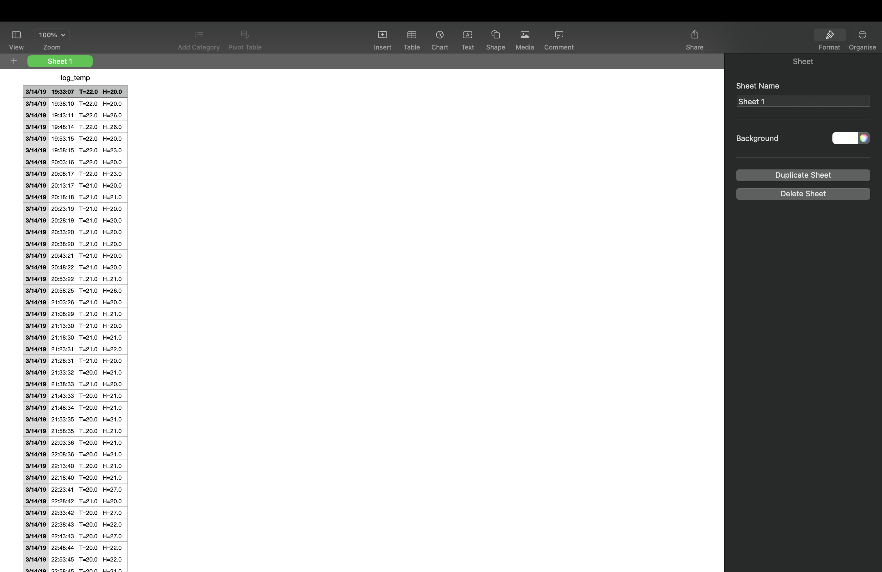
Dataset

Slide 16
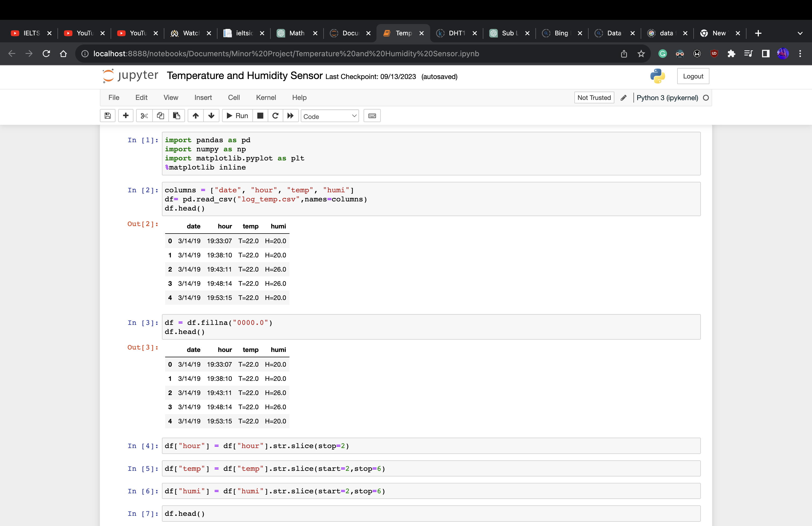
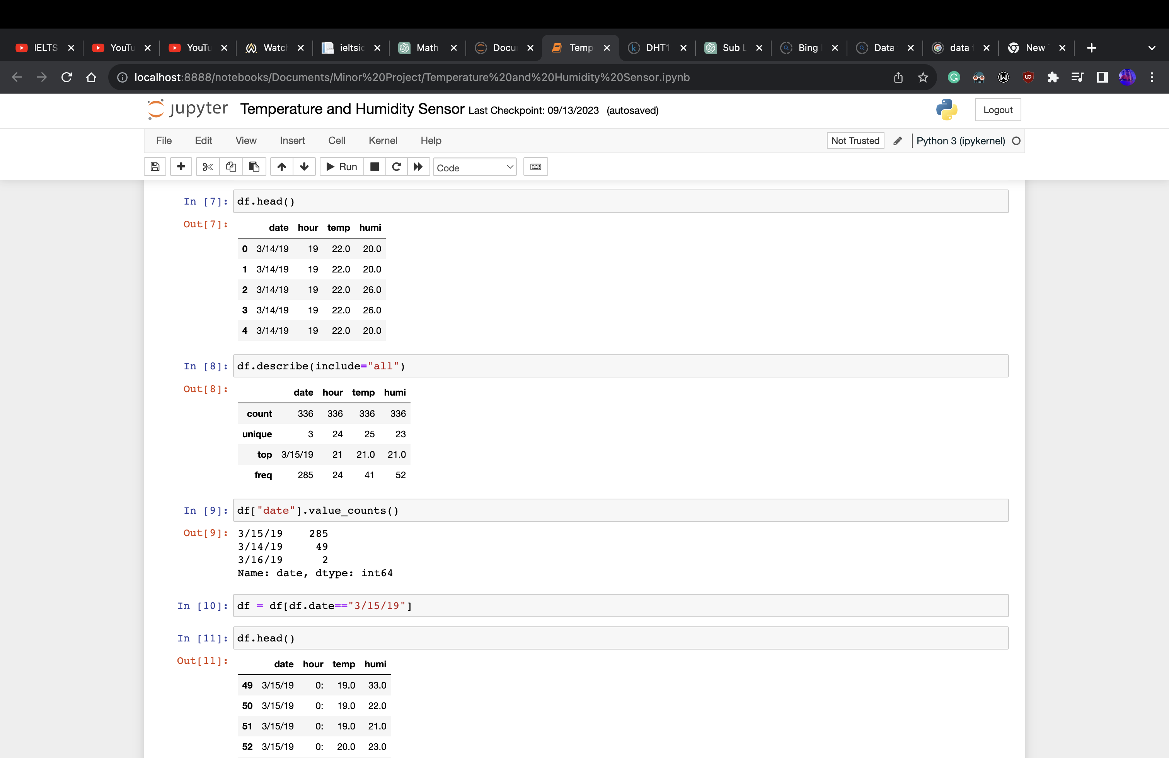
CODE

Slide 17
REFERENCES
U.S. Navy Submarine Life Support Systems https://www.sae.org/publications/technical-papers/content/911329/
Life Support Systems Design Inside the Submarines (Maritime) https://maritimereview.ph/life-support-systems-design-inside-the-submarines/
Current submarine atmosphere control technology(PUBMED) https://www.sae.org/publications/technical-papers/content/911329/
How Do Submarines Get Oxygen?(marineinsight) https://www.marineinsight.com/know-more/submarines-get-oxygen/

